Slide 1



1
Bindi Sawchuk Assistant Deputy Minister,
Workforce Innovation & Division Responsible for Skills Training
Ministry of Advanced Education, Skills and Training
Chris Brown Assistant Deputy Minister, Employment and Labour Market Services Division
Ministry of Social Development & Poverty Reduction
November 9, 2018

Slide 2

2
PART 1: BC’s Labour Market & Future Labour Force
PART 2: BC’s Priorities & Labour Market Programs
PART 3: Q&A
2

Slide 3

Things are changing quickly… we must anticipate, and respond effectively to help British Columbians reach their full potential.
3
3

Slide 4
A Demographic Shift is Underway
4
Fewer youth are entering the workforce
800
Aged 20-29 Aged 55-64
Thousands
600
400
200
0
1971
1981
1991
2001
2011
2021 2031
Source: BC Stats Population Projections
2041
4

Slide 5
Over the next decade, B.C. will have fewer workers and a tightening labour market… this could constrain future economic growth.
5
BC Unemployment Rate (2017)
Indigenous
Youth Immigrants All of BC
11%
B.C. unemployment rate is the lowest for 14 months running
Job vacancies are up 23% from one year ago
Focus is on increasing labour force participation in under represented groups & across all regions
8.6%
6.9%
5%
Cariboo Kootenay
Thompson Okanagan
Northeast North Coast/Nechako Vancouver Island/Coast Lower Mainland/Southwest
7.4%
7.3%
7.1%
5.9%
5.8%
5.0%
4.6%
Source: BC 2018 Labour Market Outlook
5

Slide 6
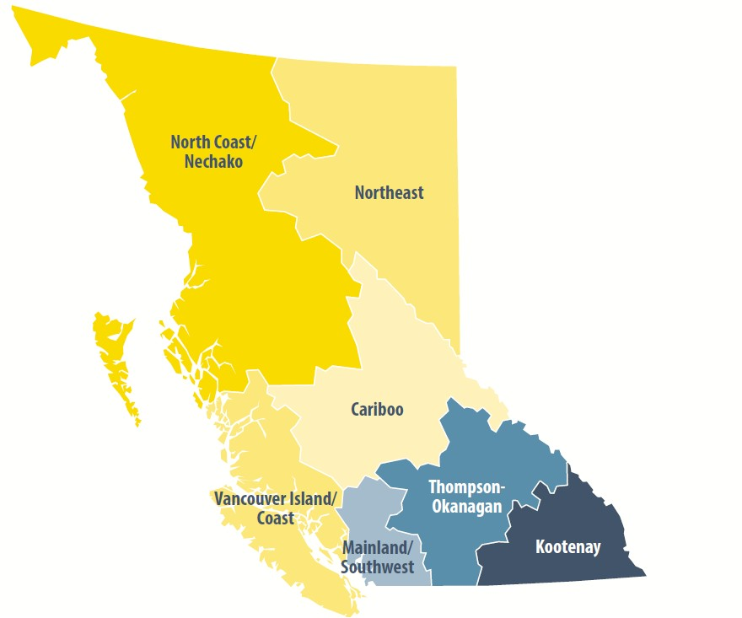


10 Year Job Openings by Region
6
14,380
18,080
91,190
24,080
12,990
153,820
588,470
Source: BC 2018 Labour Market Outlook
6

Slide 7










903,000 Job openings over 10 years
7
32%
Resulting from growth
68%
Replacing existing workers (retirements, deaths & exits from workforce)
Source: BC 2018 Labour Market Outlook
7

Slide 8
High School and/or specific occupational training
8
77% of Job Openings will Require Post-Secondary
Bachelor’s Degree Graduate Degree
20%
20%
36% 903,000 3%
Job Openings
Less than high
36%
3%
school
41%
41%
Diploma, Certificate or Apprenticeship
Source: BC 2018 Labour Market Outlook
8

Slide 9
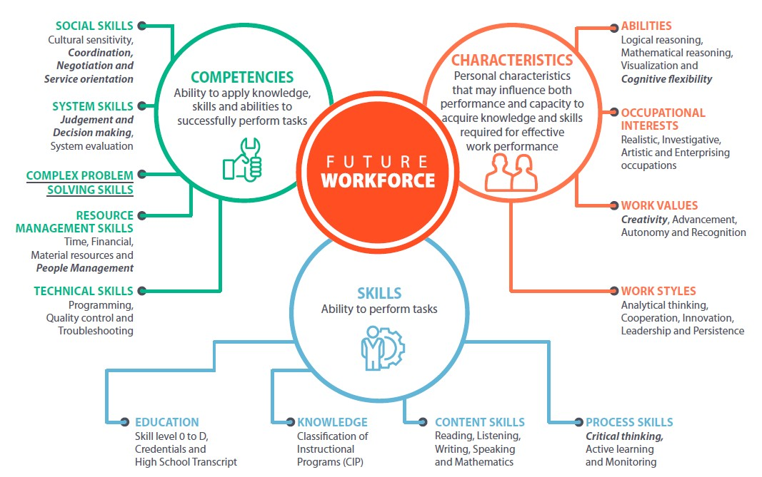
9
9

Slide 10



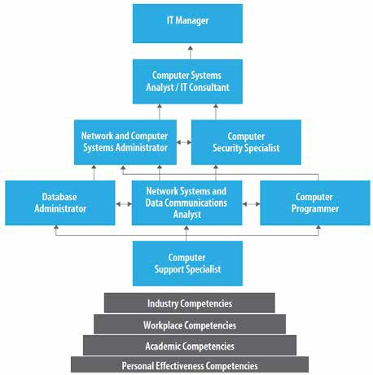
Occupational Clusters
10
Career Ladders & Lattices
Accountants
Automotive Trades
Child Care Occupations
Construction Trades
Engineering Professions
Foods Trades
Health Professions
Resource Sector Professions
10

Slide 11
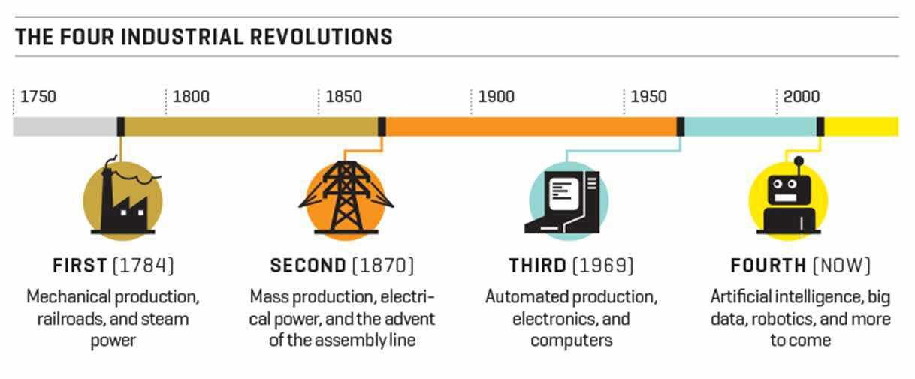

11
Automation and AI will impact low-skill jobs, but not eliminate them
Socio-cultural factors are also drivers of change
Source:
11

Slide 12

Automation Impact – B.C. Estimate
12
In the next 10 years, 166,000 jobs (20%) are expected to be affected (in whole or in part) by automation.
Some sectors are struggling to fill job vacancies, including many jobs that are lower skilled and repetitious.
Automation can also create opportunities to increase productivity in higher skilled occupations.
Source: BC 2018 Labour Market Outlook
12

Slide 13

Lower education/skill occupations are at greater risk of automation impact
13
Number of Occupations Impacted
Food Counter Attendant
Admin Assistant
Admin Officer
Book keepers
Carpenters
Lawyers
On-the-job training
Secondary School and/or occupational training
Diploma,
Certificate
or Apprenticeship
Bachelor’s or Graduate Degree or higher
Managerial: Combination of Education & Experience
Lower
Education / Skill Level
Higher
13

Slide 14
What’s the Urgency?
51
Having a skilled workforce to participate fully in a dynamic economy is critical for individual British Columbians and businesses to prosper.
Skills and education are a key component to reducing poverty… and the time is now
The speed of change in the labour market requires rapid upskilling and innovation in training
This is a complex, dynamic labour market – no one party can solve it… we must work together
14

Slide 15
Are we equipping people with the adaptable skills needed to enable labour market participation in rapidly changing economy?
What Do We Need to Ask Ourselves?
How are we reaching populations that are vulnerable and face multiple barriers to employment?
What do we need to do to support workforce development and meet regional and occupational demands?
Other?
15

Slide 16

… How is government responding to the imperative of this rapidly changing labour market?
14
16

Slide 17
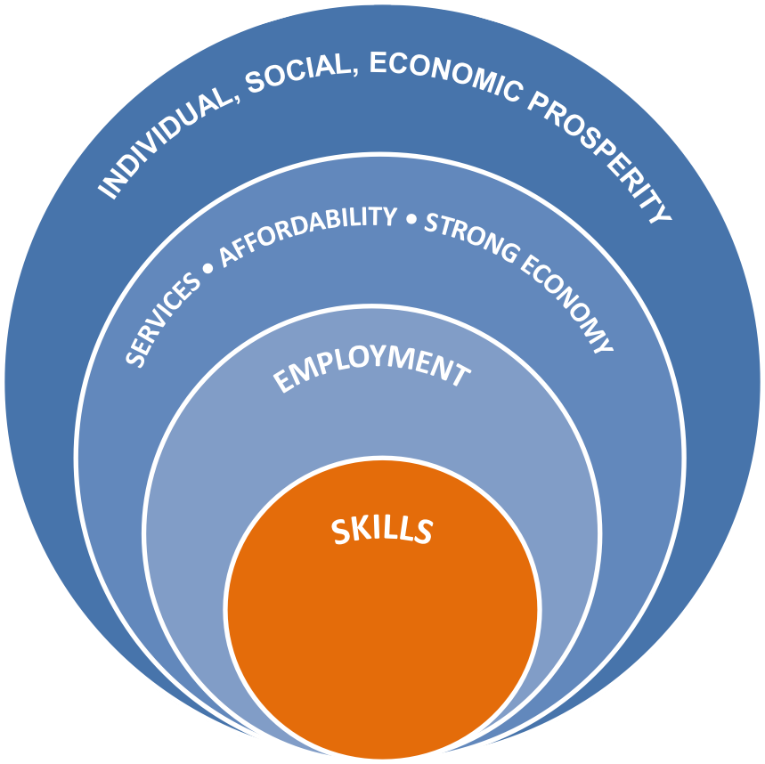

Skills and employment lead to:
15
Increased income
Stable housing
Economic independence
Improved overall health & well- being
Increased business investments
Higher GDP
Higher consumer confidence
Social stability
Social cohesion
Economic sustainability
17

Slide 18
BC Government Priorities
14
Make life more affordable
Strong, sustainable, shared economy
True & lasting Reconciliation
Deliver services people count on
Poverty Reduction Strategy
Child Care Strategy
Clean Growth Strategy (LNG)
Draft 10 Principles
Housing Strategy
MH & A Strategy
Tech Strategy
Youth in Care Transitions
GBA+
Accessibility
18

Slide 19
Federal /Provincial Partnerships
34
Labour Market Transfer Agreements
Coordinating Opportunities
    Forum of Labour Market Ministers (FLMM)
    Future Skills Centre - Skills Council – finding new ways to provide skills training to meet labour market needs
    Inventory of innovative and best practices
Workforce Development Committee (WDC)
    Oversee implementation of federal/provincial agreements
    Program planning & complementarity
Workforce Development Agreement (Ministry of Advanced Education, Skills and Training)
Labour Market Development Agreement (Ministry of Social Development and Poverty Reduction)
Confidential: Ministry Use Only
19

Slide 20

18
Advanced Education, Skills & Training
20

Slide 21



18
Skills Training Program Approach
Participants gain skills for sustainable employment
Service Providers & Communities determine the needs and services
Outcomes Focused
Flexible
Program Principles
Enhanced collaboration to address complex needs in a rapidly changing economy
Partnership Driven
Accessible
Equal access to services for urban and rural communities
21

Slide 22
WDA Programming
19
1
Unemployed, vulnerable and under-represented British Columbians
2
Communities (regional &
3
BC Employers
Indigenous) / Sectors
Skills Training for Employment Program
$52M / Year
Community Workforce Response Grant
$10 - $15M / Year
BC Employer Training Grant
$8 - $11M / Year
Skills training aligned with labour needs, and employment supports for sustainable employment
Targeted to those facing barriers to labour market participation
Third-party services delivered under contract
Programming meets urgent, local labour market challenges & opportunities
Funding up to 1 year for skills training and employment supports leading to jobs
Application-based grant, delivered w/ community or sector representative
Employer-driven training for new or current employees
Basic skills, skills upgrading, & retraining to adapt to changing skills needs
Application-based
grant, delivered w/ employer
22

Slide 23




Skills Training for Employment Program: Total Funding: $52M
20
Serves six unique populations with barriers to employment
Youth (General)
Youth at risk/exiting care
Survivors of Violence
Older Workers 55+
Multi-Barriered*
Indigenous Persons
*Those who face multiple barriers to employment, including refugees, persons with disabilities, former inmates, or issues such as homelessness, mental health, addiction.
23

Slide 24
Supporting government’s commitments to the Truth and Reconciliation Commission Calls to Action and United Nations Declaration on the Rights of Indigenous Peoples.
21
1
Established the Indigenous Programs Unit - all Indigenous skills training programs in one place
2
Indigenous Skills Training Alignment - will inform the development and delivery of future Indigenous skills training programs
3
Indigenous labour market information
24

Slide 25










3 Streams: $10-15M per fiscal
22
Emerging Priorities Indigenous Communities Workforce Shortages
Purpose: Supports communities undergoing a significant shift in the local labour market.
Examples:
Natural disaster
Mill closure
Mine opening
LNG
Purpose: Supports Indigenous communities to gain skills training.
Purpose: Supports sectors and industries in addressing workforce shortages.
Examples:
Entrepreneurship
Early Childhood Education
Tourism
Examples:
Manufacturing
Forestry
Health
Opened September 24, 2018, and is currently accepting applications
25

Slide 26
23
Objective: Assist employers to provide skills training to current and new employees to respond to rapidly evolving, skills-based labour needs
BC Employer Training Grant
$8-$12M
$300,000
maximum amount per employer per fiscal year
Three Streams
Foundational Training
Technical Skills Training
Workforce Training
Essential, transferrable and certified
In response to automation and technological advancements
Upgrading employees’ skills to align with business needs
Type of Skill
Industry/sector
Advanced occupational training, leadership, management and soft skills
Examples of Training
certification, apprenticeships, ECE,
New software, technology, machinery
accredited essential skills
26

Slide 27
Year 2
2018/19
24
Consulting with employers and other stakeholders on labour market needs
Developing new programs
New BC Employer Training Grant (Apr)
New Community Workforce Response Grant (Sept)
Procurement for new Skills Training for Employment programs begins – Youth/Youth at Risk posted (Sept)
Fully transition to new Program Framework
New Skills Training for Employment programs fully implemented
WDA
Program Transition Complete
Year 1
2017/18
Year 3
2019/20
27

Slide 28
25
Unemployed
Not-Employment Ready Lack Basic Skills & Face Barriers
Unemployed Employment-Ready Lack Job Skills / Connection to Jobs
Employed / Under- Employed
Precariously Employed
Lack Job Skills
Skills Training for Employment (WDA)
Indigenous Skills Training (ISTDF, ACBTPF)
Entry-level Trades (WDA)
Individuals
WorkBC Centres (LMDA)
ITA Trades Training
Persons With Disabilities programming (WDA)
Post-Secondary Education
Communities & Employers
Community Workforce Response Grant (WDA)
Community and Employer Partnerships (LMDA)
BC Employer Training Grant (WDA)
Promotion of Work Integrated Learning
Other Supports
Student Aid BC
Apprenticeship Supports
Income & Disability Assistance
LMI & Outreach
BC Poverty Reduction Strategy
Accessibility - by 2024
Indigenous Post-Secondary Policy & Programs
Funding for training in priority sectors
SLMP for employer / industry sector workforce needs (LMDA)
28

Slide 29

Social Development & Poverty Reduction
26
26
29

Slide 30

27
Year in Review
Confidential: Ministry Use Only
27
30

Slide 31



Results Highlights
28
Almost 24,000 clients a year achieve employment
Approx. 31,000 clients complete Case Management services each year
On average, almost 69,000 clients
begin WorkBC Employment services every year
31

Slide 32
Inclusion Highlights
29
Inclusion Group | 2017/18 Clients | 2017/18 Employment Rate
Indigenous Peoples | 6,574 | 51%
Francophone | 530 | 62%
Immigrants | 9,657 | 69%
Clients with a disability | 18,197 | 52%
Multi-Barriered | 13,264 | 48%
Survivors of Violence and/or Abuse | 5,262 | 47%
Youth | 22,467 | 59%
Overall Employment Rate- All Clients |  | 61%
70% of clients identify as being part of an inclusion group above
WorkBC also served almost 7,900 clients in 2017/18 who live in rural and remote communities across the province
32

Slide 33

Amended LMDA
30
Additional EI funds- $196 Million over six years
Expanded definition of EI Clients:
Expanded Reach-back
Inclusion of Precariously Employed Clients
30
33

Slide 34

31
Current Priorities
Confidential: Ministry Use Only
31
34

Slide 35

32
35

Slide 36
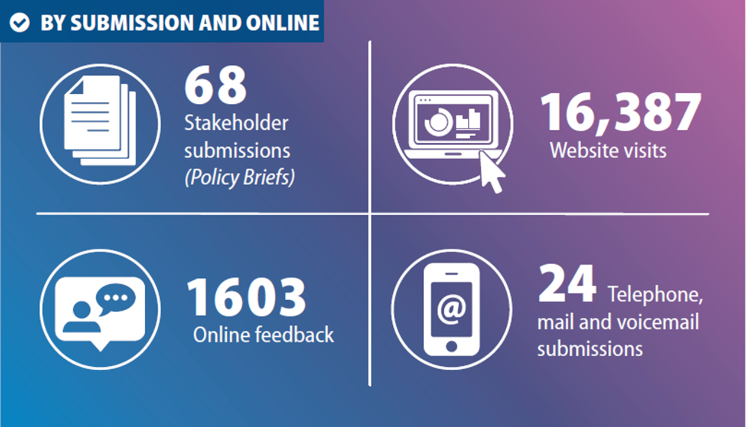
33
Confidential: Ministry Use Only
36

Slide 37

35
Confidential: Ministry Use Only
37

Slide 38

36
38

Slide 39



WorkBC Renewal
37
The Ministry is looking forward to launching the new WorkBC program on April 1st, 2019
WorkBC Assistive Technology Services
Neil Squire Society
WorkBC Apprentice Services
Douglas College
WorkBC Employment Services
TBD
39

Slide 40
WorkBC Procurement Results
38
The Ministry will announce results for WorkBC Employment Services in batches over the coming months
The anticipated dates when all vendors in a catchment would receive their results notification letter will begin in December and end in January
40

Slide 41



Timeline & Key Dates
November 2018 to April 2019
RFP Posted Publicly
Public Announcement of Results
WorkBC Program Launch
April 1 2019
Today
November
December
January
February
March
April
May
'
WorkBC Proposal Evaluation
WorkBC Contractor Training
WorkBC Contract Finalization
WorkBC Transition and Implementation
Key Milestones for WorkBC Renewal
WorkBC Employment Services RFP Posted publicly– December 2018 Notice to Vendors Issued – December 2018 to January 2019 WorkBC Employment Services Results Announced – January 2019 WorkBC Program Launch – April 1, 2019
41

Slide 42

2019 and Beyond
40
Opportunities
40
42

Slide 43
Key Changes for Clients
41
Increased the number of WorkBC Centres across the province from 84 to 98
Expanded online access to all clients to allow for accessibility from all communities
Specialized contract for Assistive Technology Services to better support people with disabilities
Program model to support job sustainment and improve employment outcomes
Simplified and plain language policy to support flexible, client centered decisions
43

Slide 44
Key Changes for Contractors
42
A streamlined financial model with significantly reduced data entry billing requirements
Efficient contract structure through provincial wide specialized contracts and fewer catchment contracts
Stronger and more specific performance metrics to provide more robust data to evaluate results
44

Slide 45


WorkBC Investing in Jobs
43
WorkBC Program | 2019-20
WorkBC Employment Services | $249,015,000
WorkBC Apprentice Services | $13,500,000
WorkBC Assistive Technology Services | $5,900,000
WorkBC Community & Employer Partnerships | $18,900,000
TOTAL | $287,315,000
WorkBC Program
2019-20
45

Slide 46
Opportunities for WorkBC
44
Stronger Relationships
Enhanced Ministry presence
Employer engagement
Guiding Principles:
Client centered | Efficient and Effective
Accessible | Flexible
Results focused | Stainable
Accountable
46

Slide 47
New Approach for WorkBC
45
The new WorkBC model creates an opportunity to enhance and improve client services by:
Taking advantage of expanded eligibility and flexibility in the LMDA to provide service to more British Columbians
Better supports to vulnerable clients and the working poor to help them get better paying jobs, reduce poverty and support BC’s growing economy
47

Slide 48
Community Projects
46
Revisioning Community Employer Partnerships
Leverage partnerships to address communities and labour markets in need
Investigate funding partnership possibilities with other Ministries
Engaged and proactive presence
48

Slide 49
Indigenous Relationships
47
Strengthening & Improving relationships
Significant focus of resources for government, our Ministry and our division
Engaging with Indigenous communities when creating new policies and programs, and reviewing services
Alignment of priorities with draft principles
47
49

Slide 50

Cross Government Engagement & Collaboration
48
Renewed relationship through the Labour Market Transfer Agreement’s
Collaboration across government
Community Organizations
Stakeholders
50
50

Slide 51

Connecting BC to Employment
48
"I was able to look at things with a different perspective and was able to learn how to accept that this was a journey and with the help of WorkBC, I was able to successfully find a job that was suitable for me.”
WorkBC Client
51
51

Slide 52
Questions?
54
Part 3
52

